Slide 1
Midterm Project
Atharv Gopaluni

Slide 2

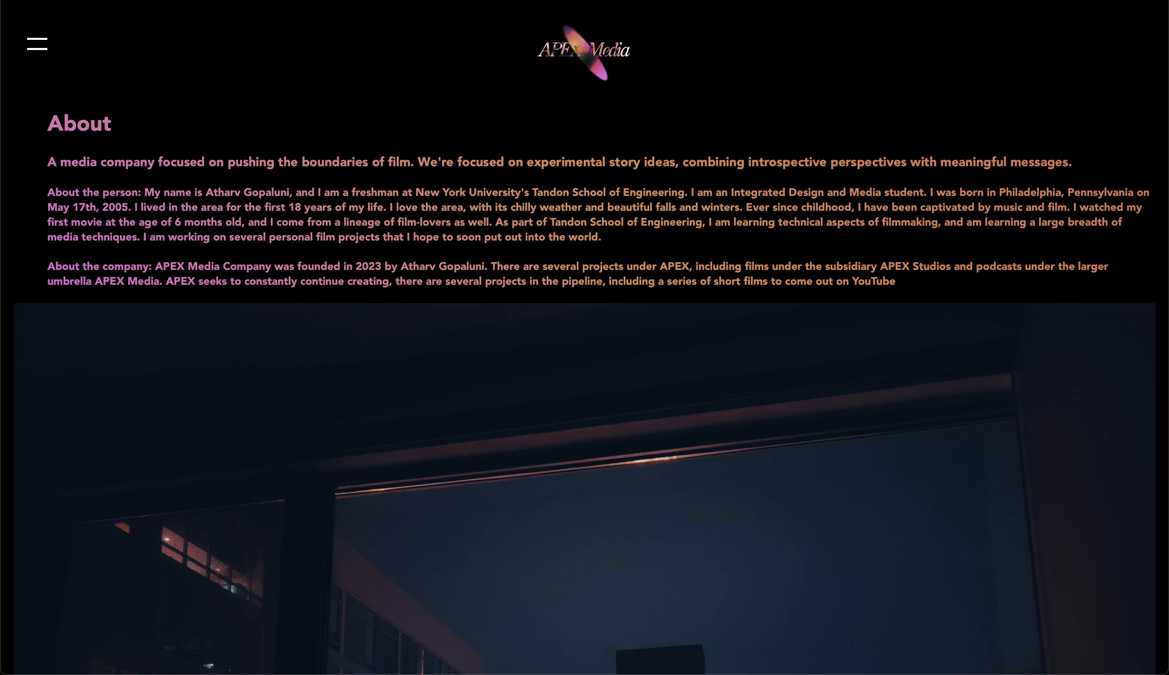
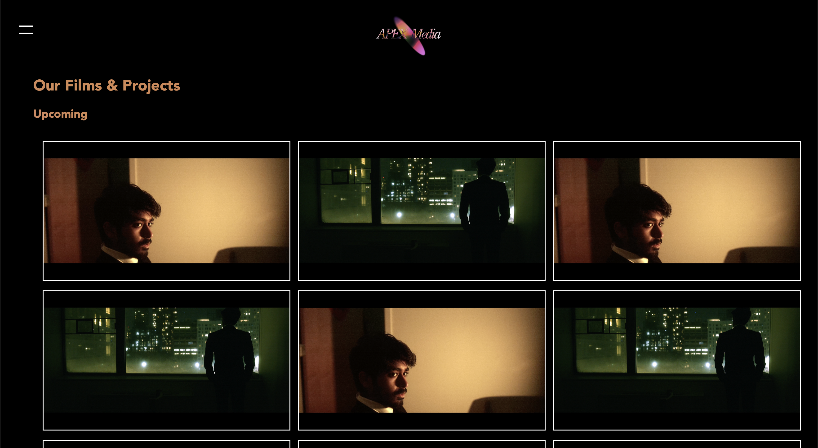
APEX Media Company Website - Demo
The website can be found at this address:
https://apexmediacompanywebsite.s3.us-east-2.amazonaws.com/index.html
Homepage
About Me Page
Films Page

Slide 3



Original mockups

Slide 4
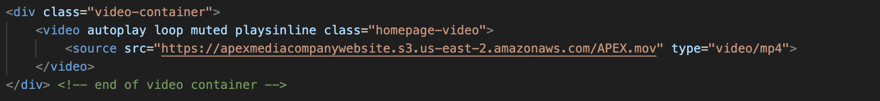
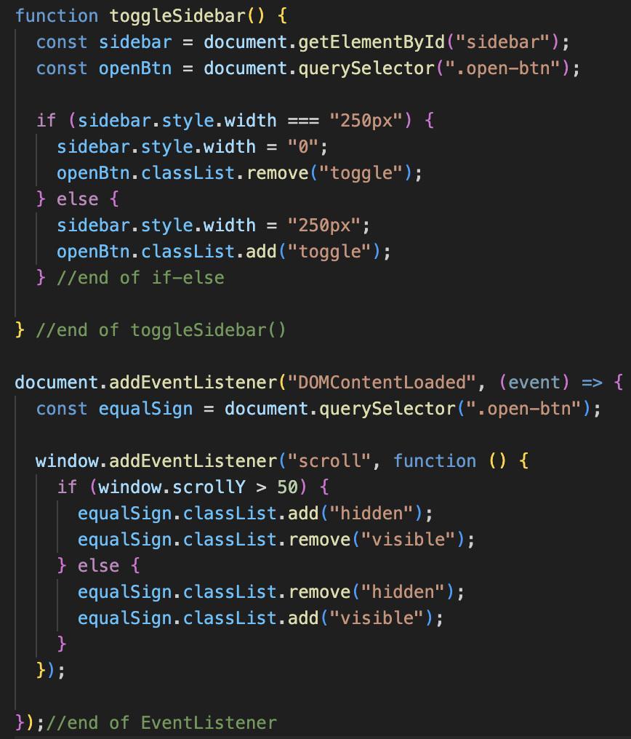
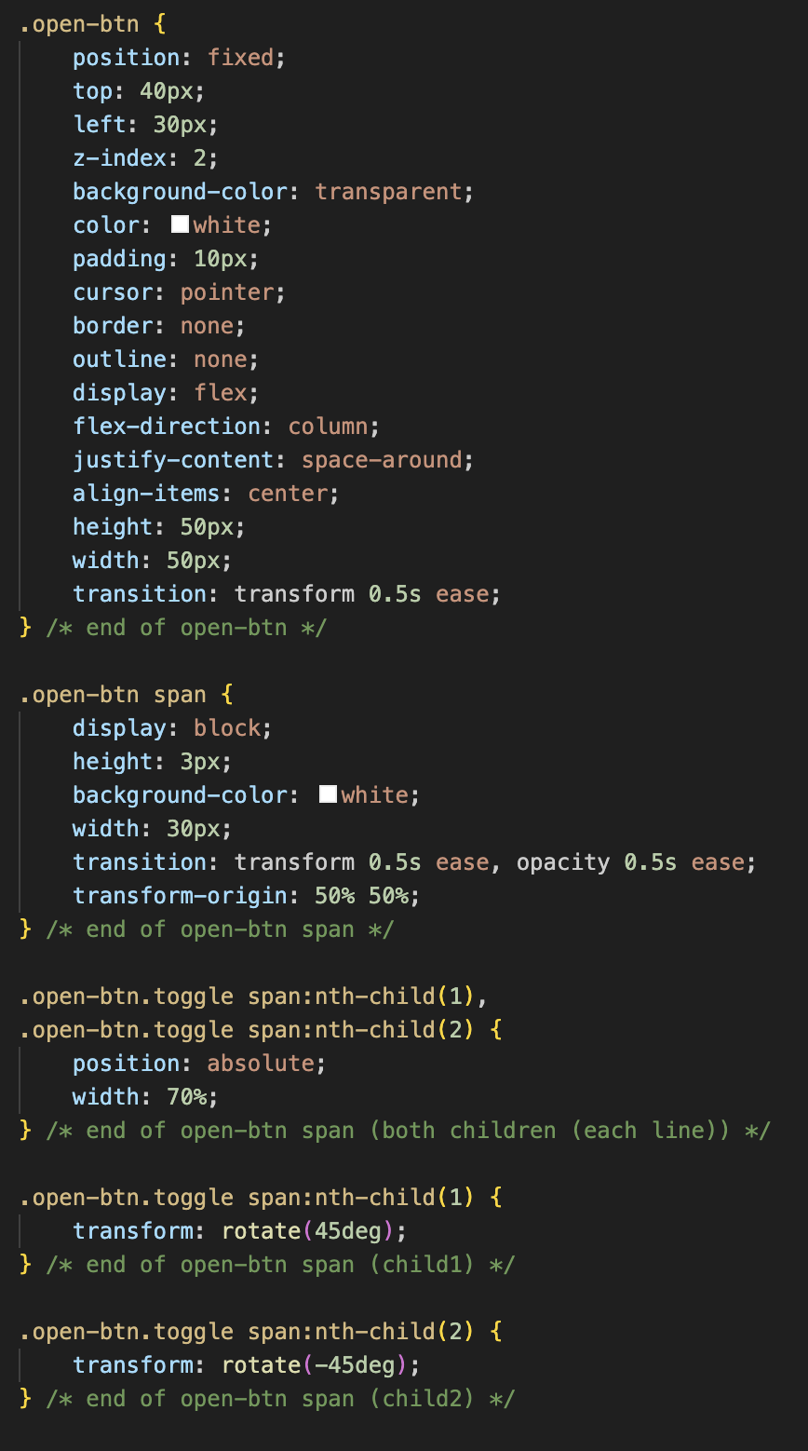
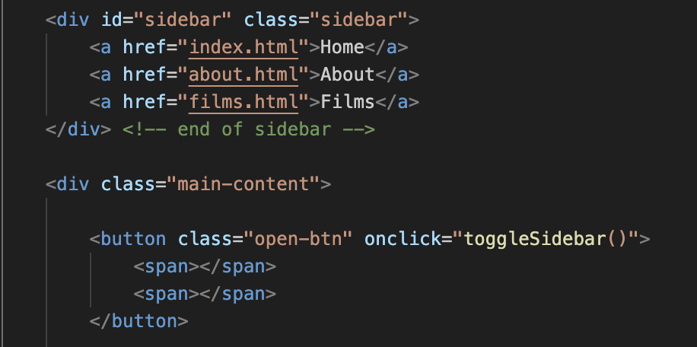
Code snippets
HTML Video Tag on Home Page
Corresponding HTML
JavaScript for sidebar animation and disappearance
Corresponding CSS

Slide 5
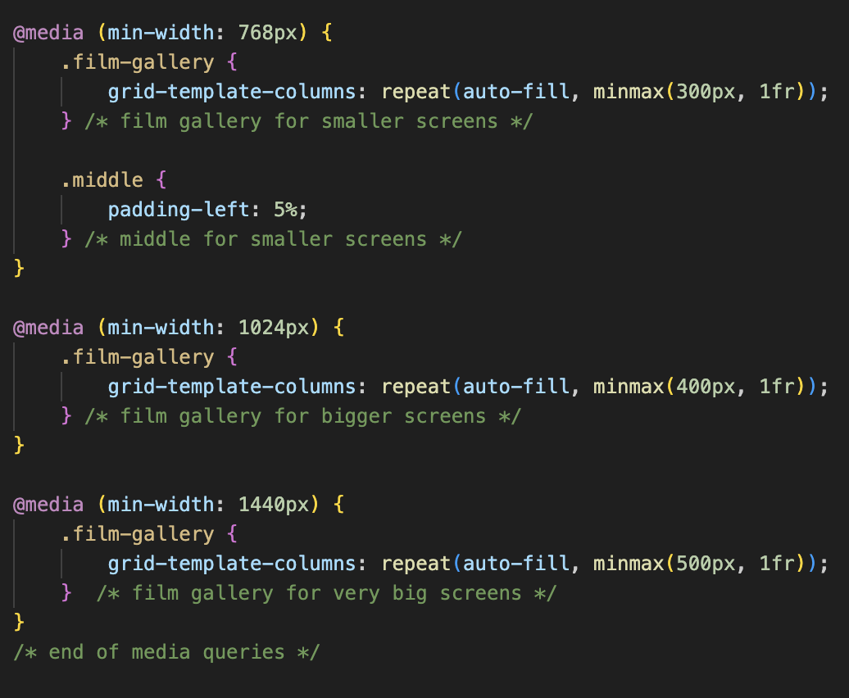
Media Queries

Slide 6
Next steps
Further animation
More pages
More subpages, as projects grow in size
Different pages for different possible divisions
More animation, perhaps a moving noisy background

